Slide 1

COLLEGE MANAGEMENT SYSTEM
Supervised By:
Mrs. Ruchi Gupta Ma'am
Asst. Professor
Department of Computer Engineering & Applications

Slide 2
Submitted by: Adesh Chauhan (Univ. Roll No.-171500014) Anugrah Agarwal (Univ. Roll No.-171500054) Aryan Sethi (Univ. Roll No.-171500061) DEPARTMENT OF COMPUTER ENGINEERING APPLICATIONS Institute Of Engineering and Technology GLA University Mathura-281406,INDIA 2019
SUBMITTED BY

Slide 3
Why College Management System
WHY??
Every organization whether big or small, has challenges to overcome and managing the information of Course, College, Faculty, Exam, Students.
Every College Management System has different needs, therefore we design exclusive employee management systems that are adapted to your managerial requirements.
These systems will ultimately allow you to better manage resources.

Slide 4
INTRODUCTION
INTRODUCTION
College Management System is an internet based Web Portal that aims at providing information to all levels of management system for the College. This system can be used as an information management system for the college.
For a given registrar / staff / student (Technical / Non-technical) the Administrator creates login & password, using these registrar/ staff / student (Technical / Non-technical) can access the system to either upload or download some information from the database.

Slide 5
BENEFITS AS A USER
BENEFITS
The software facilitates the faculties to scores of the students of the college.
The software gives the information such as student personal data, student fees details, results etc.
Generating the print reports of student personal, fee as well as result details….
Hence we conclude that the present system (CMS for Colleges) would definitely help the user by saving time and effort by reducing the processing time and volume of errors.
The user satisfaction would be definitely higher when compared to the old manual system.

Slide 6
BENEFITS AS A PRODUCT
BENEFITS
The main benefits of developing the current project entitled “COLLEGE MANAGEMENT SYSTEM ” is to build effective system which is fast, accurate, consistency, reliable and flexible enough so that it can incorporate any future enhancements.
By automating the system using computers, sophisticated technology can be used for making the information more flexible, accurate, and secure and user friendly.
Every user such as student and staff can able to see the information of each student through online from anywhere and anytime.

Slide 7
ADVANTAGES
ADVANTAGES
Time Saving: Our college management system is developed with a primary aim of 'Saving Time.
No Complication: Major complication part for College Management System is adding a student details or managing their examination scores section.
Cost Effective: It's cheaper. You don't have to purchase multiple copies of software to install on multiple computers.

Slide 8
TECHNOLOGIES USED
TECHNOLOGIES USED
JavaScript: It is a programming language, commonly use with web browsers
PHP: Hypertext Preprocessor (PHP) is a technology that allows software developers to create dynamically generated web pages, in HTML, XML, or other document types, as per client request. PHP is open source software.
MySQL: MySQL is a database, widely used for accessing querying, updating, and managing data in databases.
HTML :For user interfaces
CSS : For making interfaces more attractive and stylish
Bootstrap 4: For make website responsive.

Slide 9
Admin Portal

Slide 10
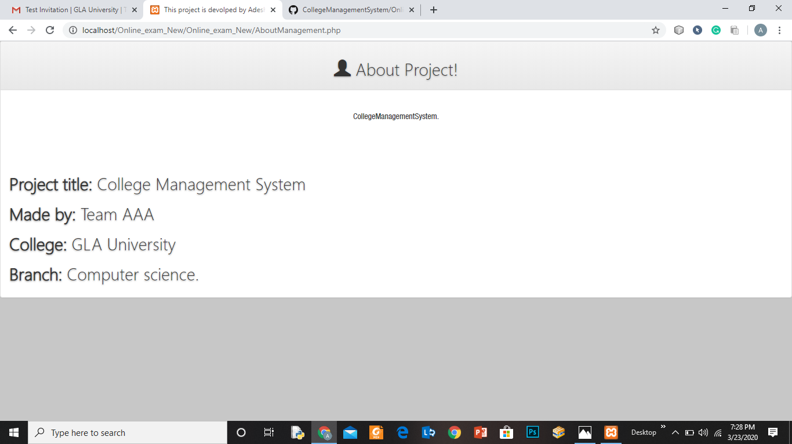
ABOUT PROJECT

Slide 11
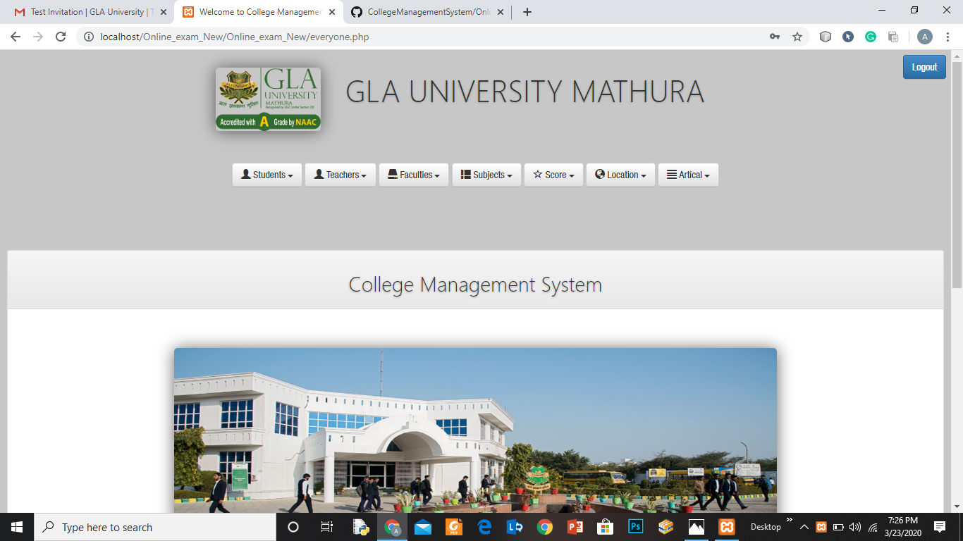
Login Page

Slide 12
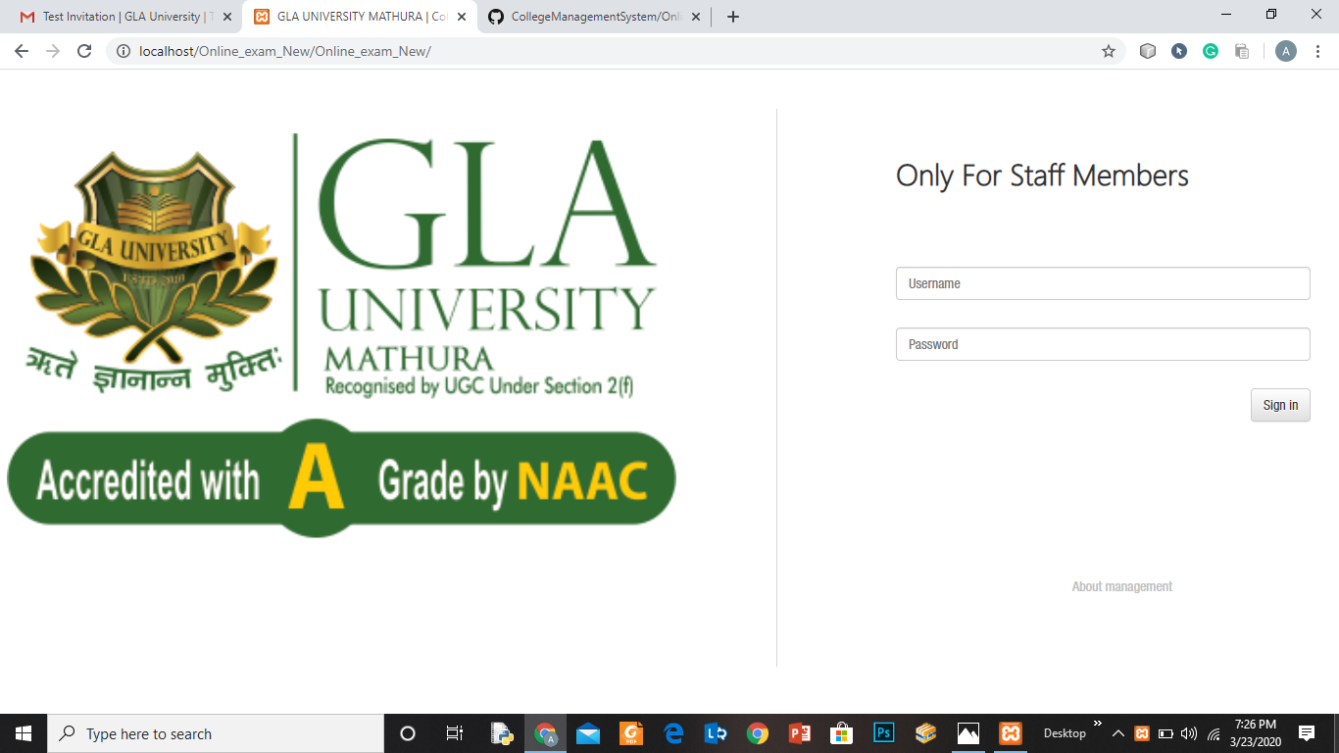
Login

Slide 13
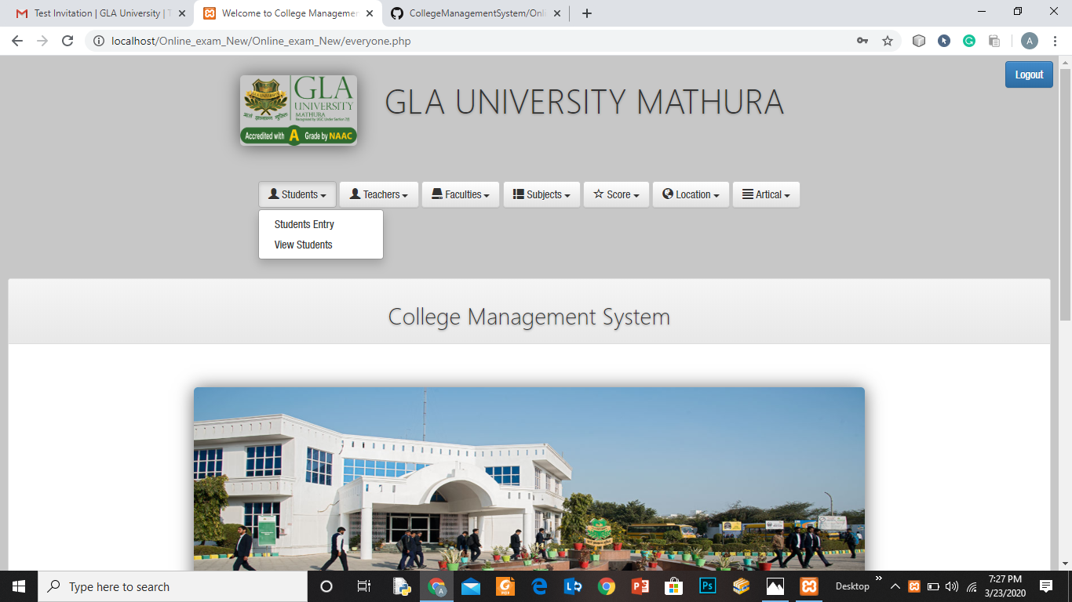
DROPDOWN MENU

Slide 14
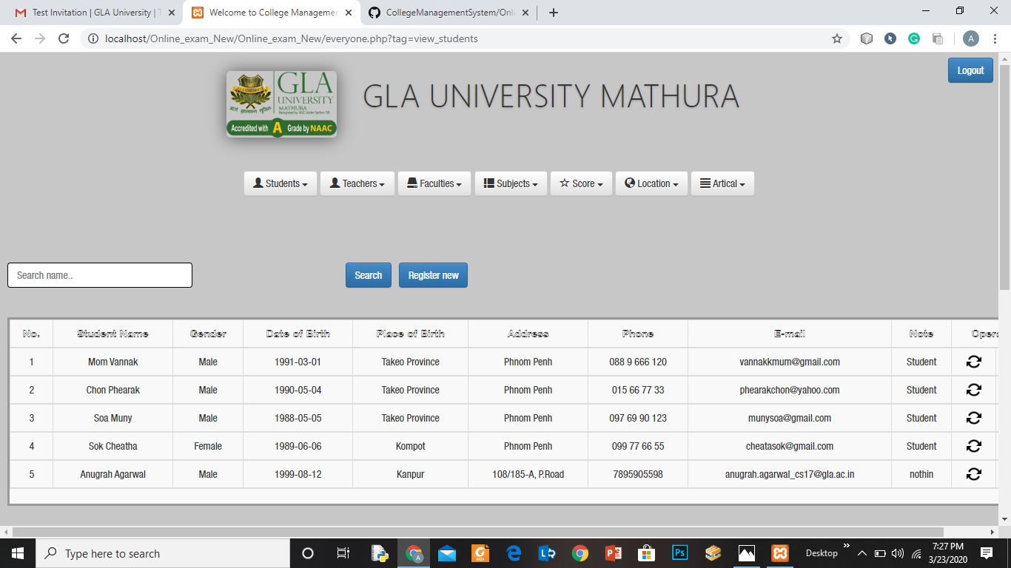
LIST OF STUDENTS

Slide 15
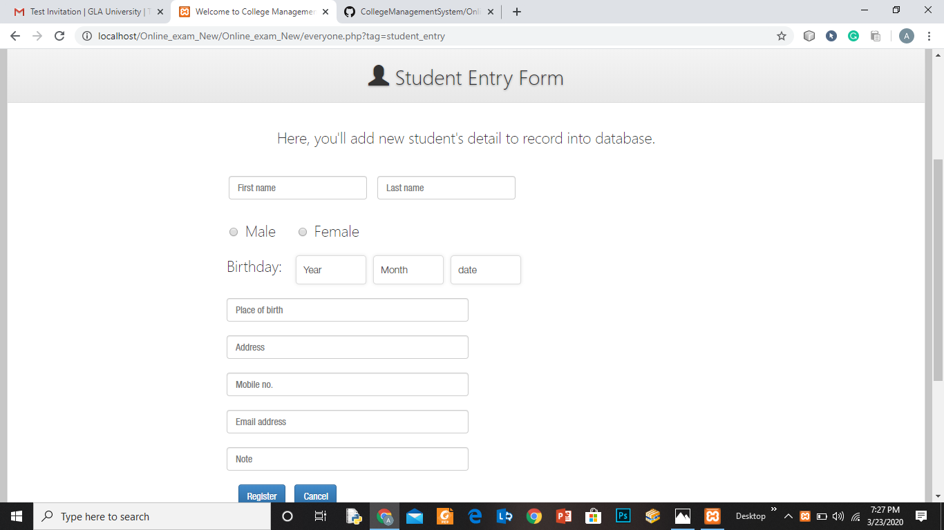
STUDENT ENTRY FORM

Slide 16
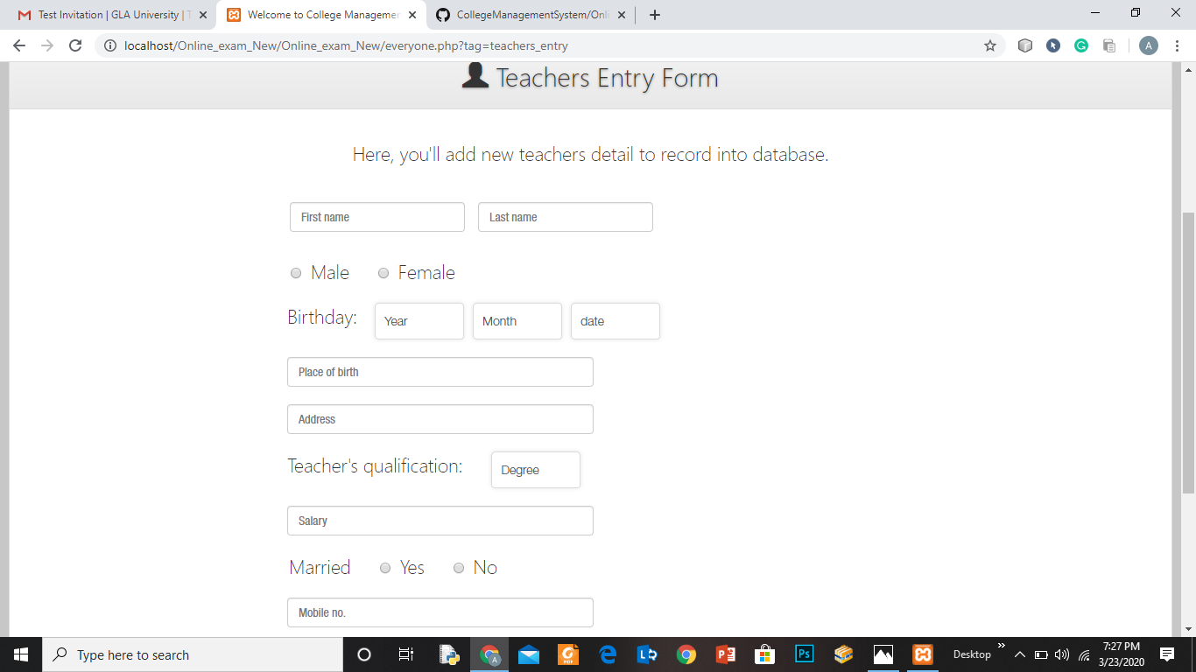
TEACHER ENTRY FORM

Slide 17
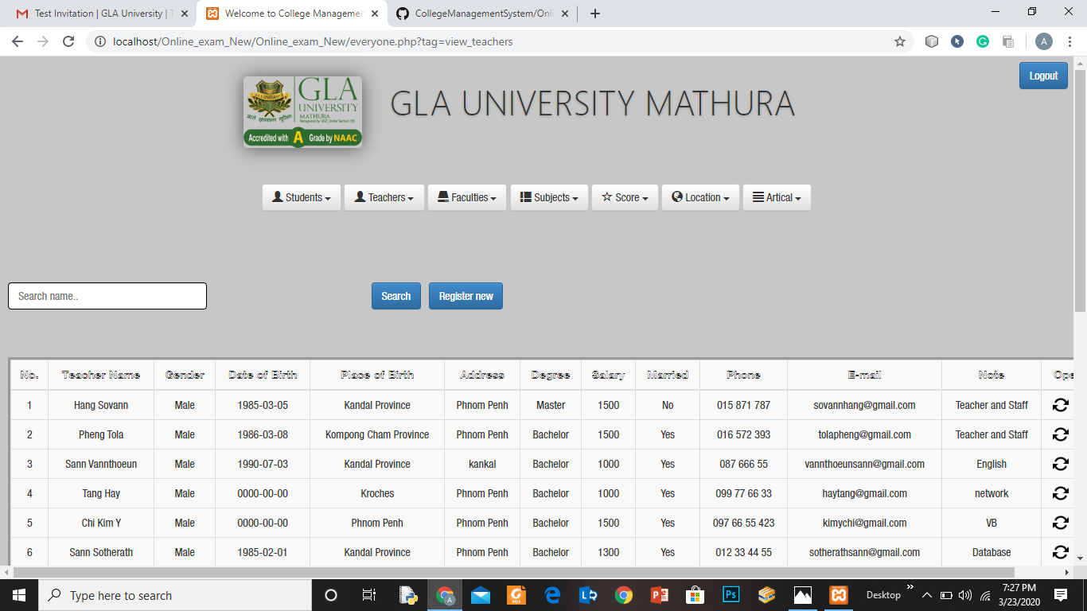
FACULTY LIST

Slide 18
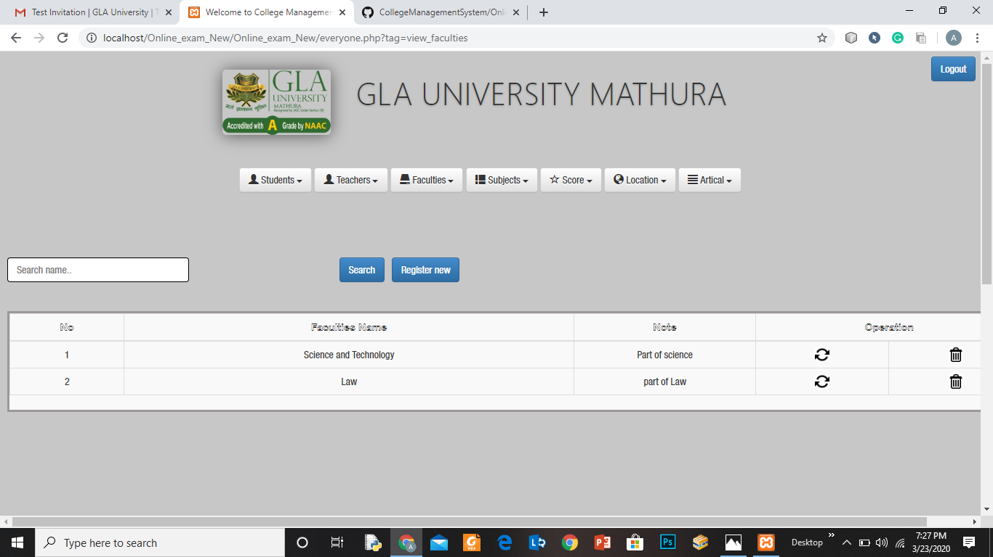
SUBJECT LIST

Slide 19
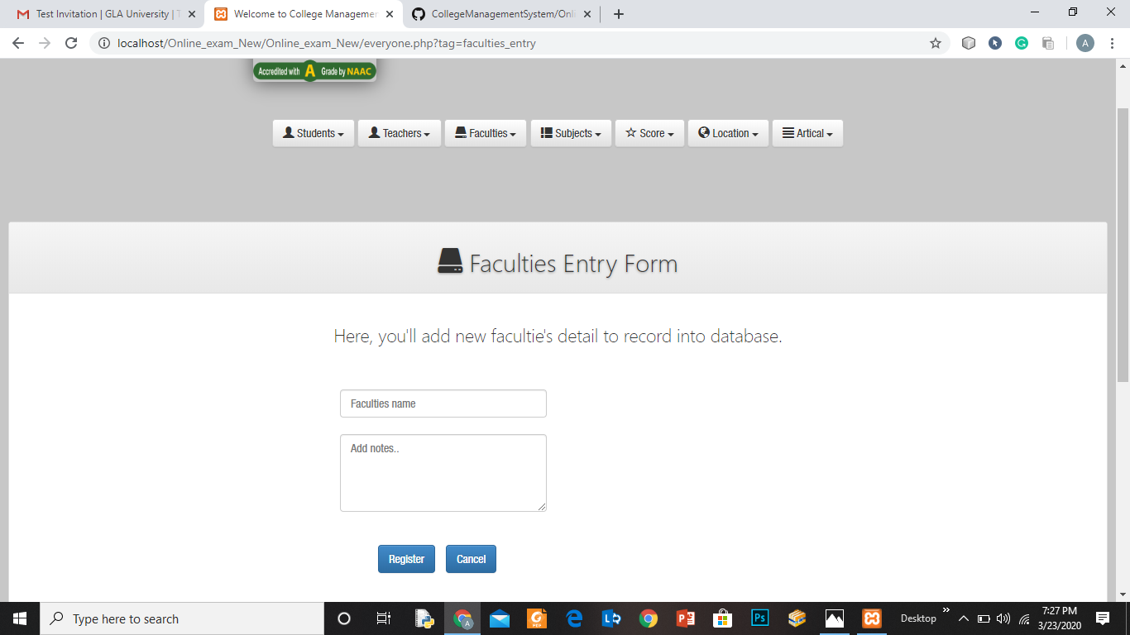
FACULTY ENTRY FORM

Slide 20
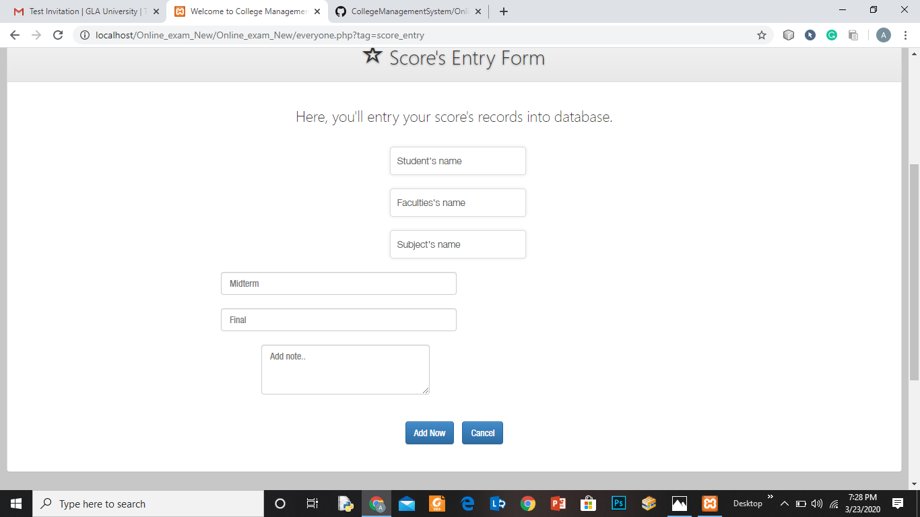
MARKS ENTRY

Slide 21
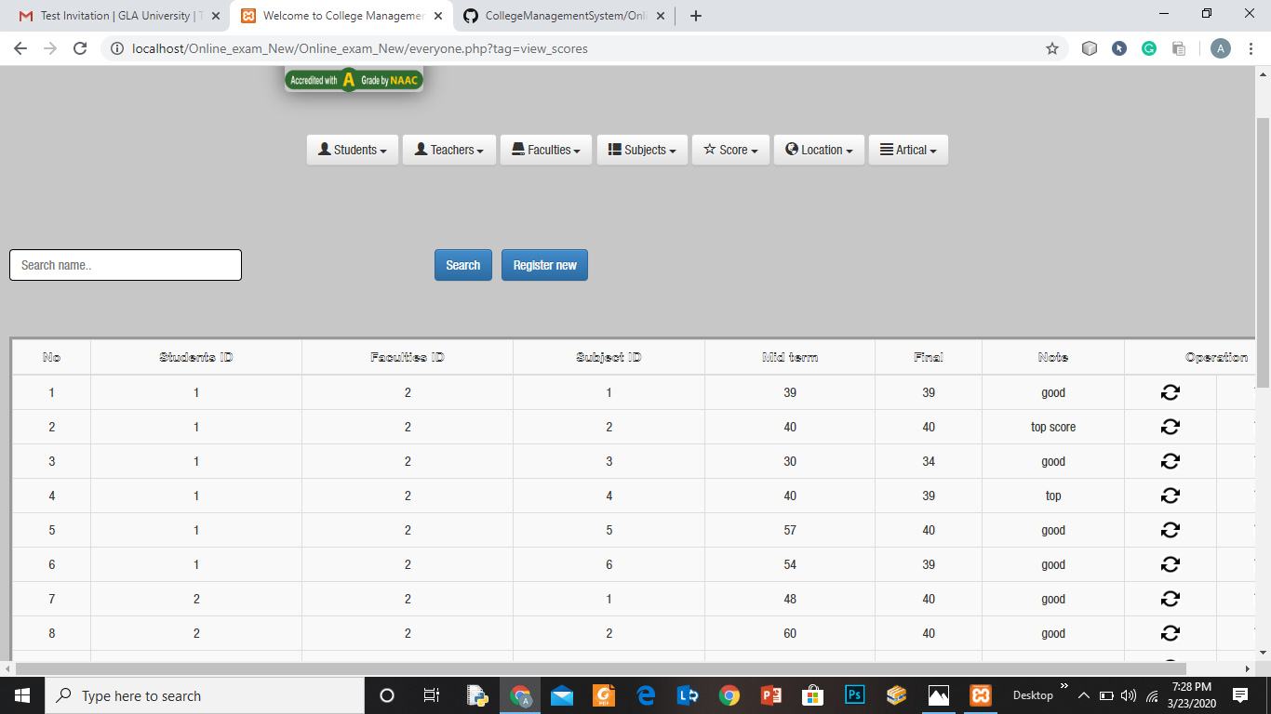
SCORE LIST

Slide 22
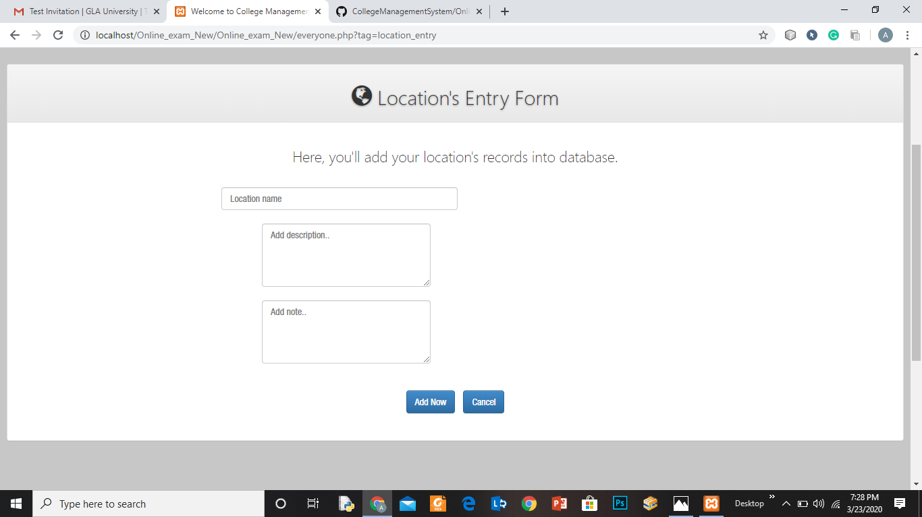
LOCATION ENTRY

Slide 23
CONTRIBUTION BY THE TEAM
CONTRIBUTION
ADESH CHAUHAN – Adesh chauhan had played a vital role in the project designing as he gave a presentable layout for the admin portal and designed the webpage for the same using various web development languages such as HTML , CSS , JAVASCRIPT , BOOTSTRAP etc.He was also responsible for making the presentation for the project.
ARYAN SETHI – Aryan Sethi had played another important role by deciding the framework and the layout of the user interface which was basically a Web portal.he decided the modules should be present and that would be accessible to the user i.e. the student at the college.He was also responsible for all the documentation work of the project. He had been given the task of making various reports for their project and defining all the modules of the project.

Slide 24
CONTRIBUTION BY THE TEAM
CONTRIBUTION
ANUGRAH AGARWAL – Anugrah Agarwal was made responsible for designing the web portal along with Aryan Sethi .He was responsible for writing various codes for implementing the desired modules made for the college management system.

Slide 25
THANK YOU

